Slide 1


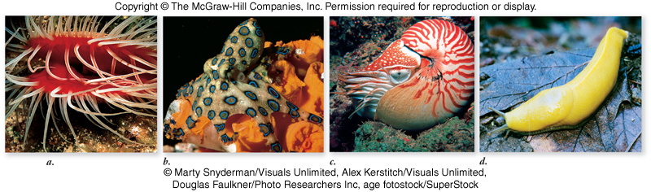
BASRAH UNIVERSITY
Faculty of Education for Pure Sciences
Biology Department
2025- 2026
Phylum Mollusca
Presented By: Prof. Dr. Sabeeh H. AL-Mayah

Slide 2
Phylum Mollusca
Mollusks evolved in the oceans and most groups have remained there.
They are an important source of human food.
They are economically significant in other ways
Pearls are produced in oysters.
Mother-of-pearl is produced in the shells of abalone.
Mollusks can also be pests.
Zebra mussel (Dreissena polymorpha)

Slide 3
Mollusks are second in diversity only to arthropods
Exhibit a wide variety of sizes and body forms
Live in many different environments
Include snails, slugs, clams, octopuses and others.
Molluscs have a muscular foot that is the primary organ used for locomotion.
Dorsal body wall forms a mantle, which is a sheath of skin that houses the internal organs and secretes a shell. (the shell is absent in some molluscs).
Most molluscs have a rasping tongue called a radula.
Most molluscs have an open circulatory system that drains into sinuses, except the cephalopods (octopus, squid, etc.) which have a closed circulatory system.

Slide 4
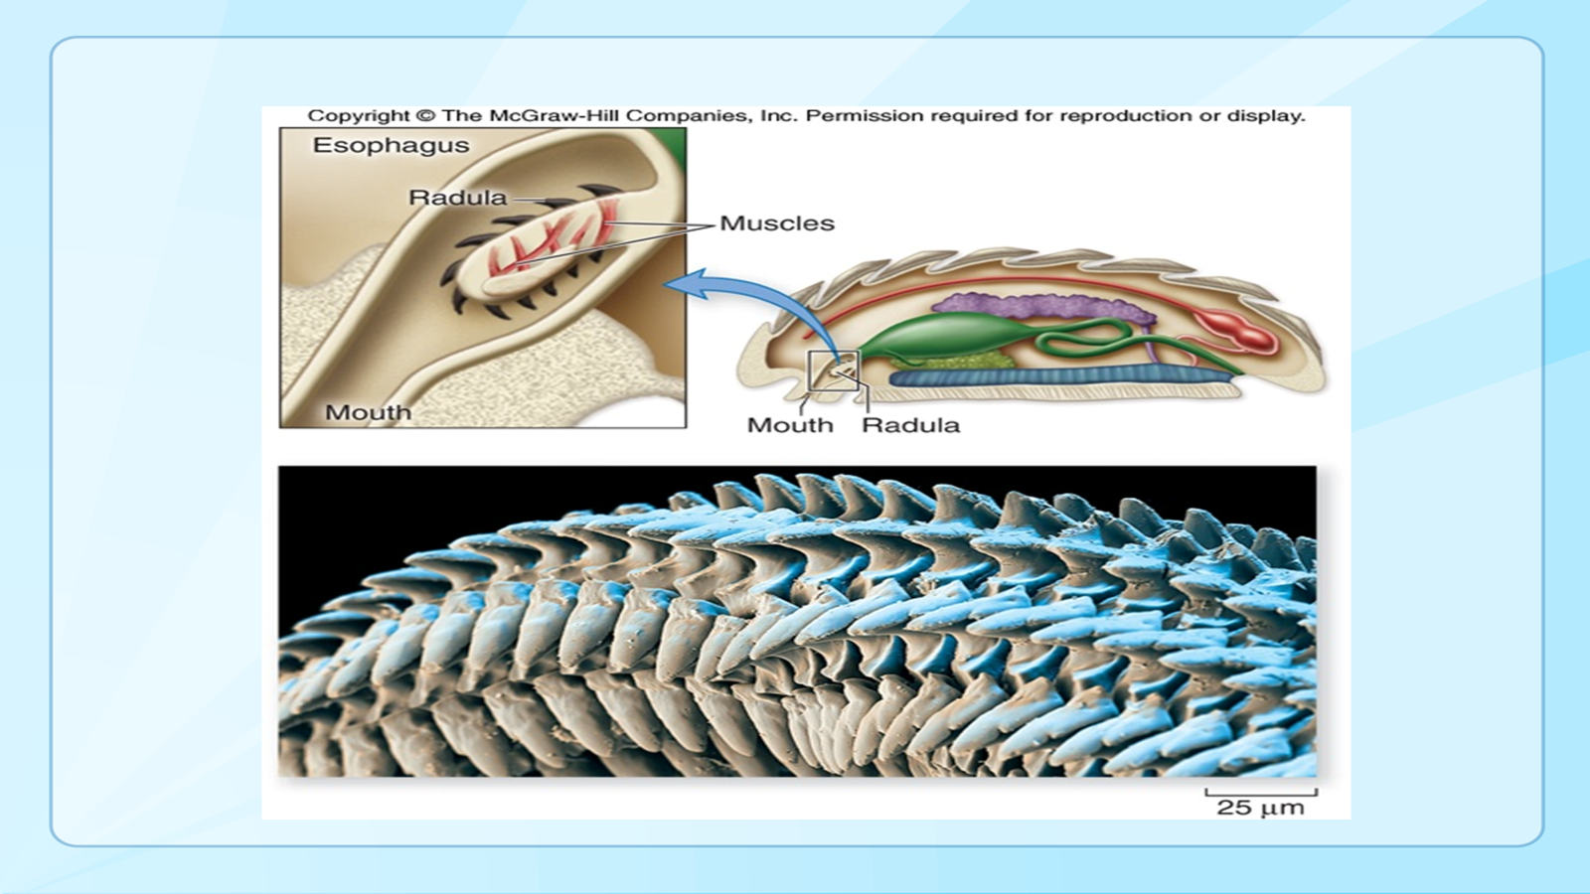
Respiration occurs by gills, lungs, through the mantle cavity or through the skin (mantle).
Usually one or two kidneys (metanephridia) empty into the mantle cavity.
Nervous system of paired cerebral ganglia.
Organ systems are well developed.
Most molluscs have a rasping tongue called a radula.

Slide 5
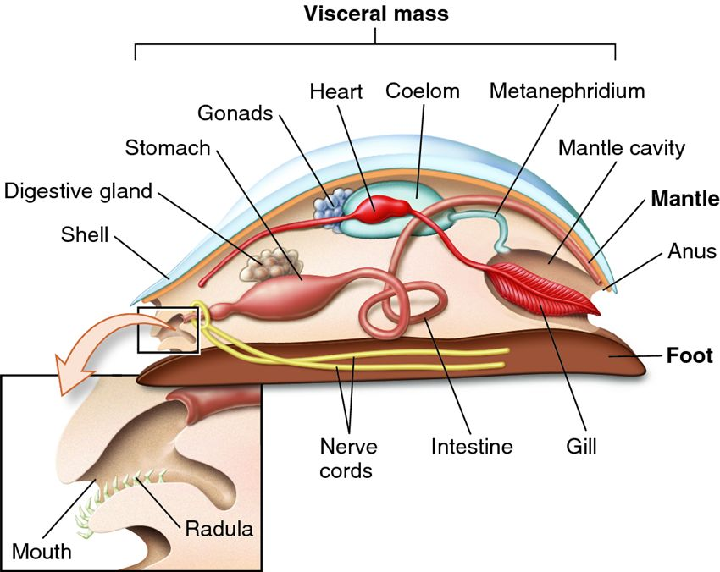
General Molluscs Anatomy

Slide 6
Molluscs Anatomy
The body of a molluscs consists of a head-foot portion, and a visceral mass portion.
The head-foot portion of the body consists of a head with a mouth and radula, eyes, tentacles, and the muscular foot (primary organ used for locomotion).
The visceral mass portion of the body consists of digestive, circulatory, respiratory, and reproductive organs.
The visceral mass is contained in the Mantle.
The outer surface of the mantle secretes a shell made of calcium carbonate and protein.
The Mantle Cavity houses respiratory organs like gills or lungs, and it also serves as a respiratory organ itself by exchanging gases.

Slide 7
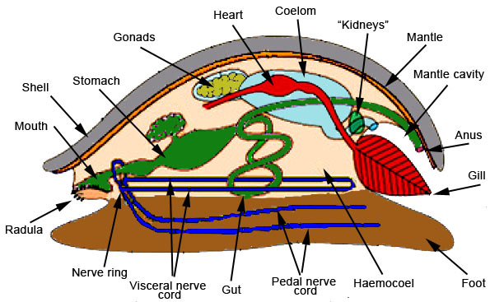
Mantle Cavity

Slide 8
Most molluscs have an open circulatory system with a heart, blood vessels, and blood sinuses (cephalopods have a closed circulatory system with a heart, vessels, and capillaries).
Molluscs Reproduction
Most mollusks have distinct male and female individuals.
Most engage in external fertilization.
Many aquatic molluscs pass through a free-swimming larva stage called a trochophore.
In some molluscs, like marine snails, tusk shells, and bivalves, the trochophore develops further into another larva stage called a veliger.

Slide 9
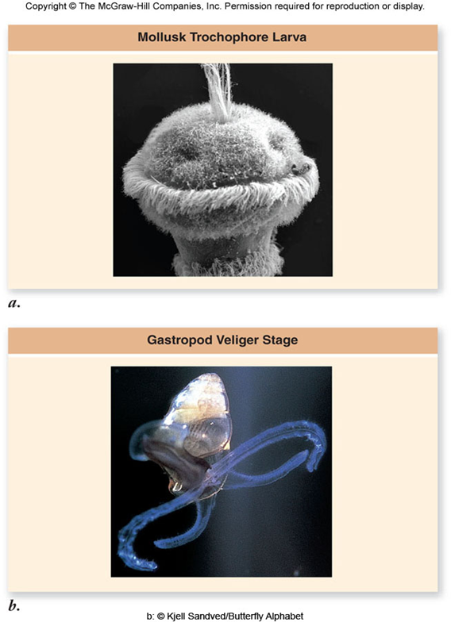
Molluscs Reproduction & Development
Indirect development
Larval stages
Trochophore larva
Free swimming, ciliated, shell formation begins
Veliger larva
Free swimming, ciliated velum forms,
Shell/body torsion occurs
Spat
Metamorphic form between veliger and juvenile
Shell elaborates

Slide 10
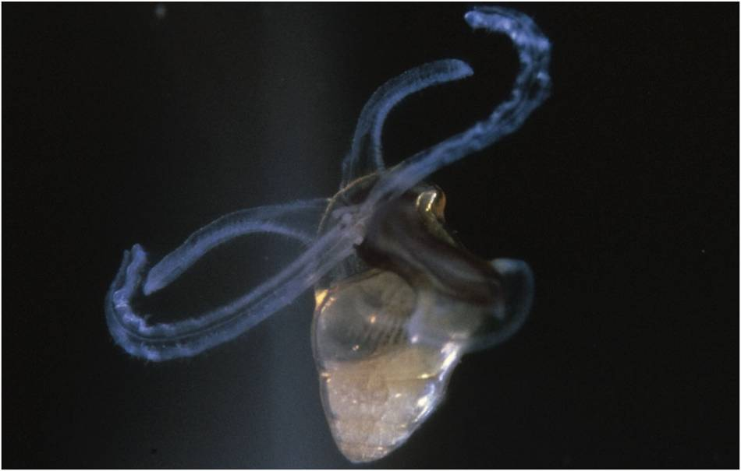
Gastropod Veliger Larva
Mouth
Velia
Shell
Notes:
Fig. 16.7

Slide 11
Ecology of Phylum Mollusca
Molluscs live in a wide variety of habitats from tropical regions, to polar regions, at altitudes of 7000 meters.
Basically, every water habitat from the high mountain lakes to the bottom of the ocean.
The ecological niches found in molluscs include bottom feeders, herbivorous grazers, predaceous carnivores, and filter feeders.
A variety of molluscs are used as food by humans and cultivated for their pearls.
Some can be very destructive and destroy wooden ships (like shipworms).

Slide 12
Molluscs Taxonomy
Monoplacophora-single shelled molluscs
Polyplacophora-chitons
Scaphopods-tusk shells
Gastropods-snails, slugs
Bivalves-clams, oysters
Cephalopods-octopus, squid, nautilus, cuttlefish

Slide 13
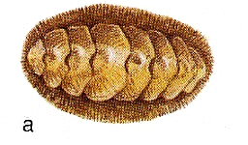
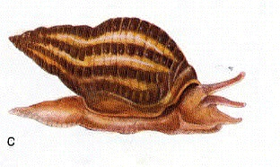
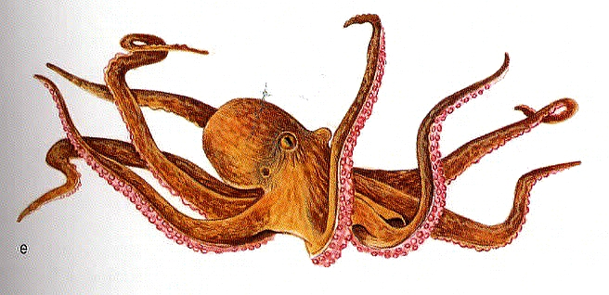
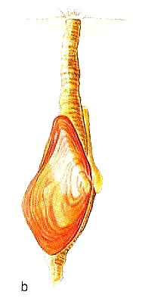
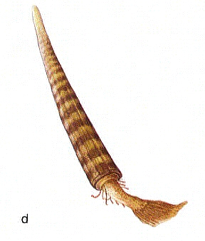
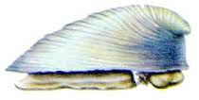
Polyplacophora
Gastropoda
Cephalopoda
Bivalvia
Scaphopoda
Monoplacophora

Slide 14
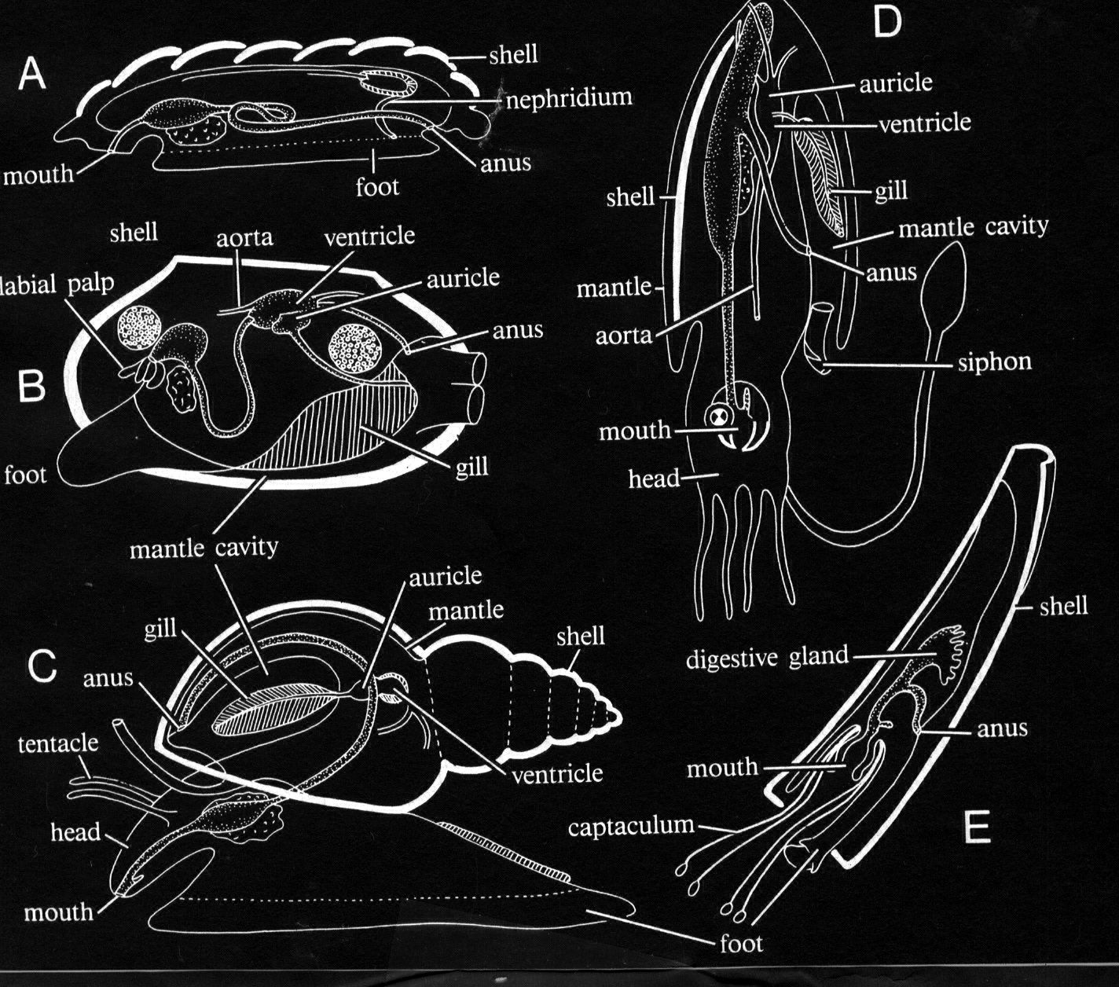
Very different, but with some important shared characters
-Shell
- Mantle
- Ctenidium
- Muscular foot
- Radular organ

Slide 15
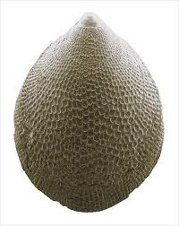
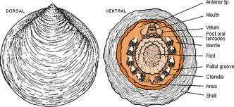
Class Monoplacophora
Limpet-like single shell
Mantle cavity with five or six pairs of gills
Radula present
Sexes separate
Only about 10 species known
Thought to be extinct until around 1952
Ex. Neopilina galatheae

Slide 16
Mollusca: General Characteristics
Other 5 Classes ~1100
Bivalvia
7,650 sp
Gastropoda
40,000 sp

Slide 17
Class Monoplacophora
Limpet-like single shell
Mantle cavity with five or six pairs of gills
Radula present
Sexes separate
Only about 10 species known
Thought to be extinct until around 1952
Ex. Neopilina galatheae

Slide 18
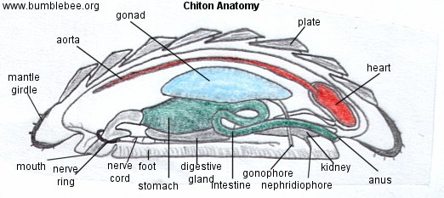
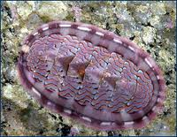
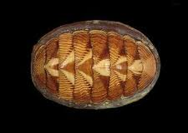
Class Polyplacophora
Chitons
Flattened body with reduced head
Radula present
Shell of seven or eight dorsal plates
Sexes separate
Trochophore, but no veliger larva stage.
Chitons are somewhat flattened and have a convex surface that bears eight (sometimes seven) calcareous plates or valves

Slide 19
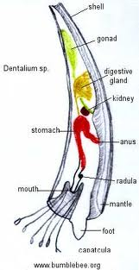
Class Scaphopoda
Tusk shells
Body in tube-shaped shell
Conical foot
Mouth with radula and tentacles
Head absent
Respiration occurs through the mantle
Sexes separate; trochophore larva

Slide 20
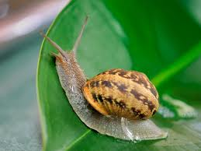
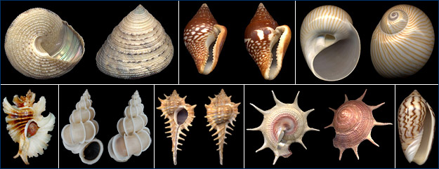
Class Gastropoda
Snails and relatives
Bilaterally asymmetrical in a coiled shell (shell absent in some).
Well developed head
Radula present
Dioecious and monoecious; some with trochophore and a veliger larva.
Most diverse group; includes the snails, limpets, slugs, whelks, conchs, periwinkles, sea slugs, sea hares, sea butterflies and others.
Some snails have a hard protein plate called the operculum that protects the body and prevents water loss.

Slide 21
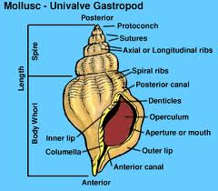
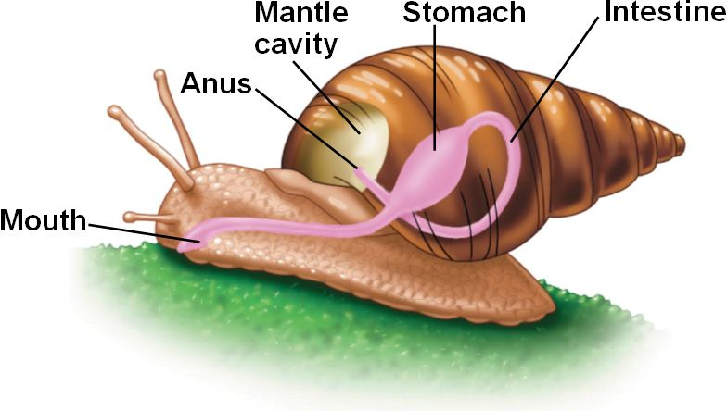
Class Gastropoda (Snails and slugs)
A primarily marine group
Heads typically have pairs of tentacles with eyes at the ends
During embryological development, gastropods undergo
1. Torsion – Mantle cavity and anus are moved from the posterior to the front
2. Coiling – Spiral winding of the shell

Slide 22
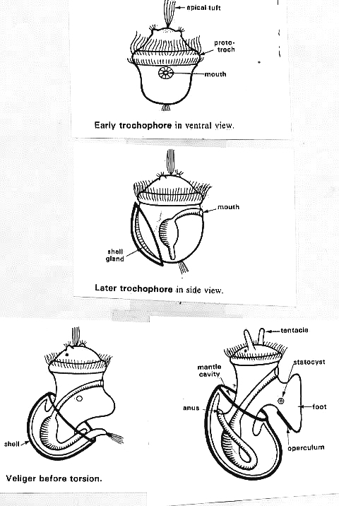
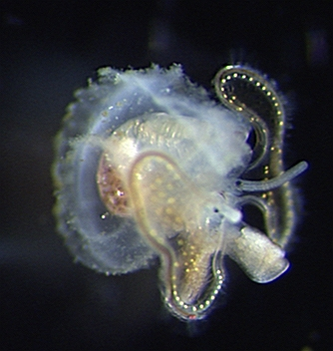
Torsion occurs during the
development of the veliger
Front
view
Early
trochophore
Later
trochophore
Side
view
Veliger
Before torsion after torsion

Slide 23
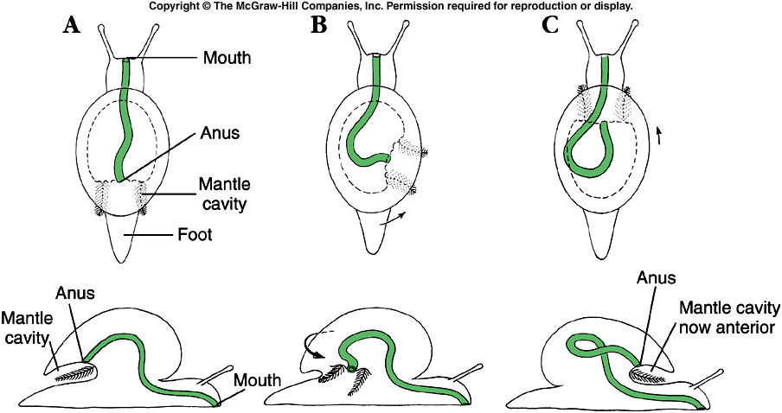
Class Gastropoda - Torsion
Notes:
Fig. 16.13

Slide 24
Are there adaptive advantages to Torsion?
Two hypotheses have been proposed
1. To bring adult coiled shell into better balance along a-p axis
2. Allows larva to pull its head and velum into the mantle cavity first
New perspectives (Louise Page Univ. of Victoria)“asymmetry hypothesis” anterior re-arrangement/enlargement of the lateral mantle cavity in a monoplacophoran

Slide 25
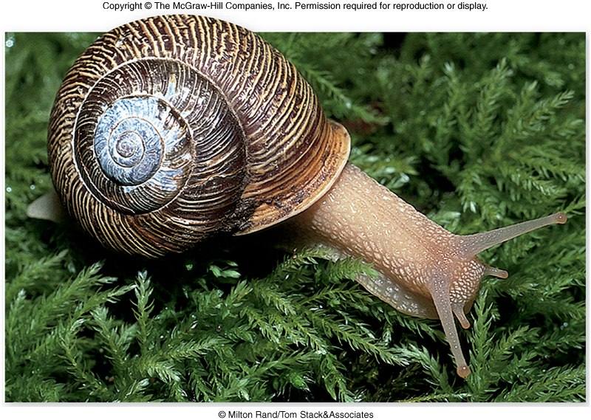
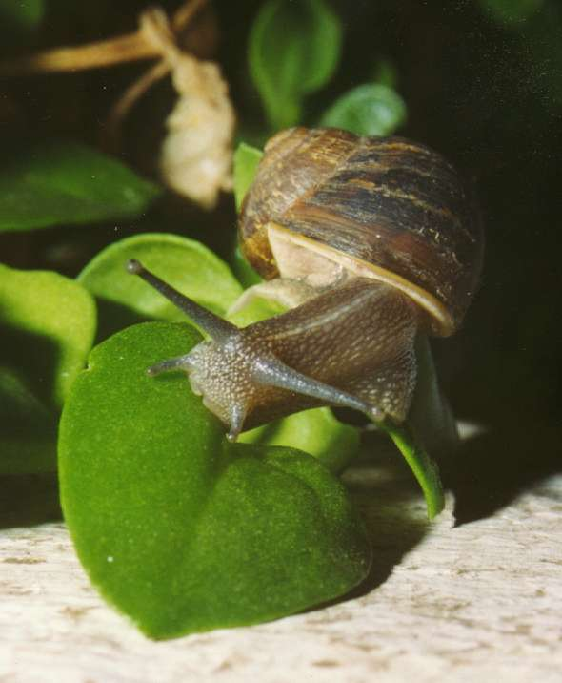
Other Molluscan Sub Classes:Pulmonata
land and f.w. snails and slugs
very few marine
Adaptations
to life
In terrestrial
Environments?

Slide 26
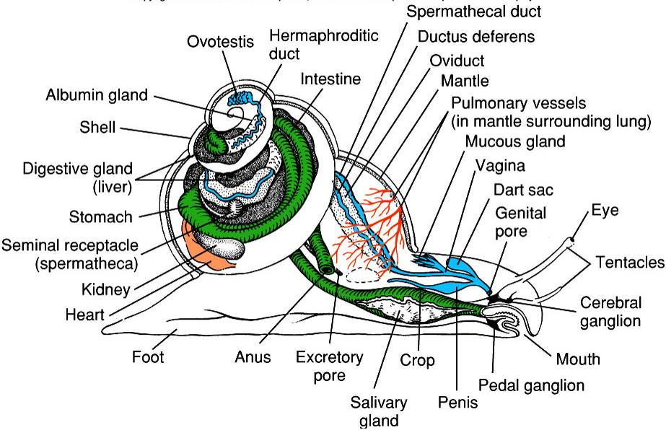
Generalized Gastropod Anatomy
Notes:
Fig. 16.18

Slide 27
Class Bivalvia (Bivalves)
Includes clams, scallops, mussels, oysters and others
Have two lateral (right and left) shells (valves) hinged together dorsally
Most are sessile filter-feeders
Water circulation is mediated by siphons and rhythmic beating of cilia on gills
Head reduced
No radula or eyes (except in some like the bay scallop)
Platelike gills
Foot wedge-shaped
Sexes separate; trochophore and veliger larva

Slide 28
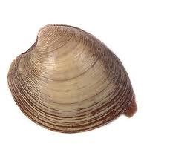
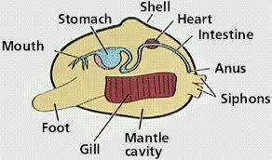
Most bivalves are suspension feeders that depend on their gills to bring in food.
No head or radula and very little cephalization.
Their two shells (valves) are held together by a hinge ligament, which keeps the two valves open.
Adductor muscles work antagonistically to keep the valves shut.

Slide 29
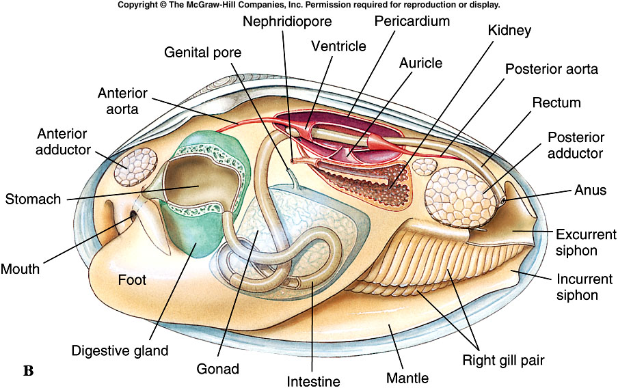
Bivalve Anatomy (Sagittal)
Notes:
Fig. 16.31b

Slide 30
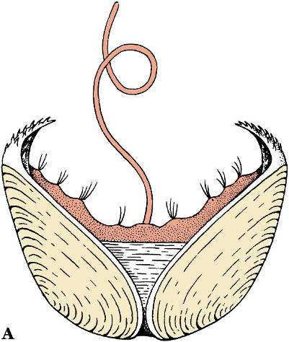
Glochidia – Unique Larval Stage of Freshwater Bivalves
Bivalve Reproduction
Internal fertilization
Early development in brood chamber (region of mantle cavity)
Release of glochidia veliger larvae
Glochidia attach to gills of fish and are distributed
Notes:
Fig. 16.35a

Slide 31
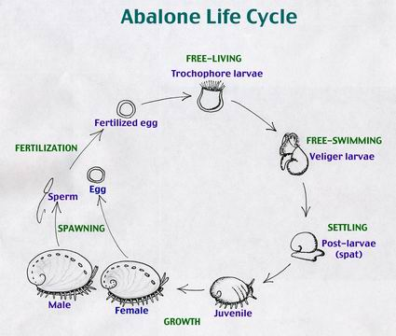

Slide 32
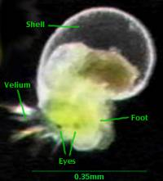
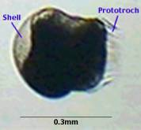
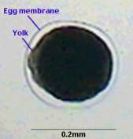
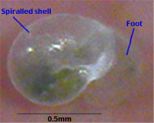
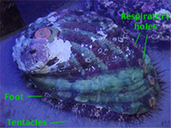
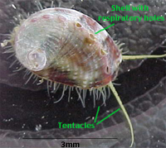
Veliger
Zygote
Trochophore
Juvenile
Adult
Spat

Slide 33
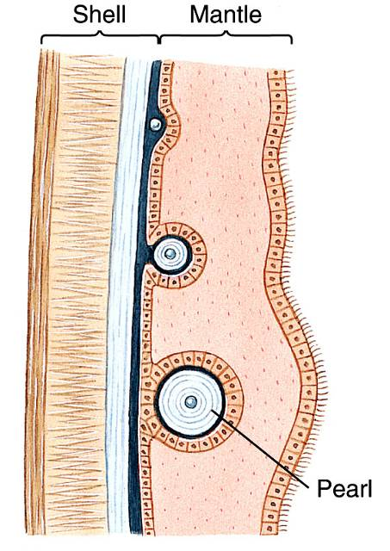
A Pearl Among the Swine
Notes:
Fig. 16.5b

Slide 34
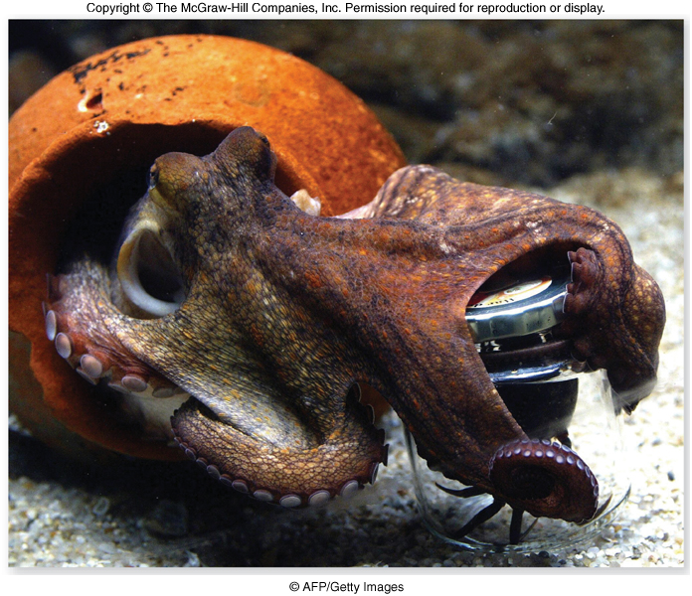
Class Cephalopoda
Active marine predators
Foot has evolved into a series of arms equipped with suction cups
Squids have 10; octopuses, 8; and nautiluses, 80 to 90
Have highly developed nervous systems
Exhibit complex patterns of behavior and a high level of intelligence

Slide 35
Cephalopods
The name cephalopod means head-foot
Their body shape is unusual in that the head and muscular foot are indistinguishable.
The foot of a cephalopod is the funnel for expelling water from the mantle cavity; they are able to move quickly by jet propulsion.
Strong beak-like jaws grasp prey, and the radula tears pieces of flesh.
Octopus and cuttlefish have salivary glands that secrete venom and immobilize prey.

Slide 36
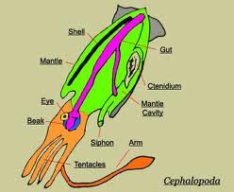
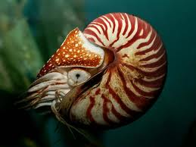
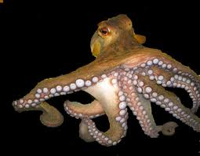
Class Cephalopoda
Octopus, Squid, Cuttlefish, Nautilus
Shell reduced or completely absent
Head and eyes are well developed with radula
Head with arms and tentacles
Well developed brain for an invertebrate
Sexes separate
Marine predators

Slide 37
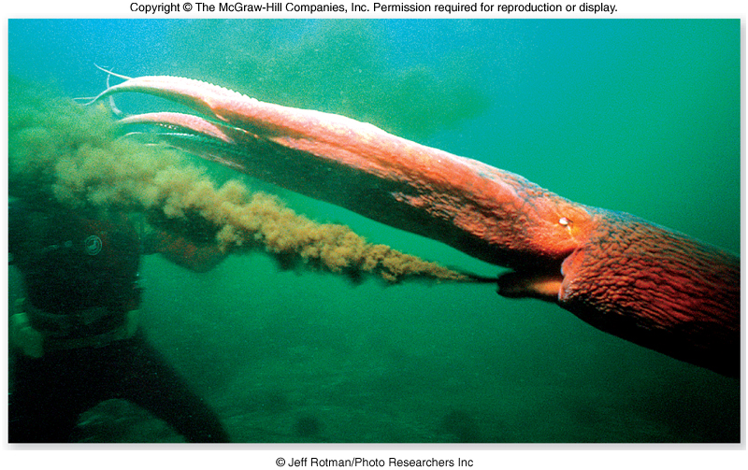
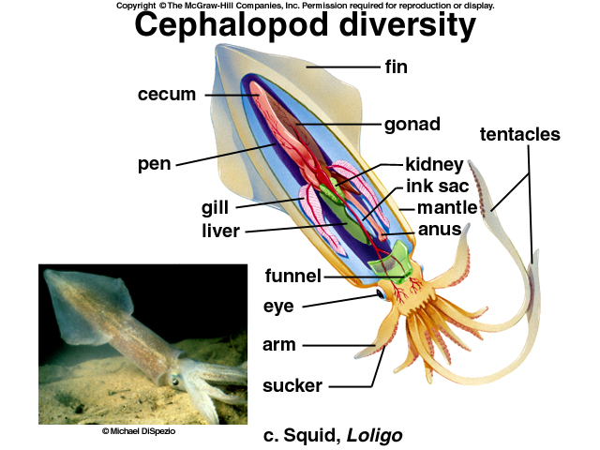
Class Cephalopoda
-Many have an ink sac and are capable of expelling ink to confuse predators.
-Octopuses and squids can change color using pouches of pigment called chromatophores.

Slide 38
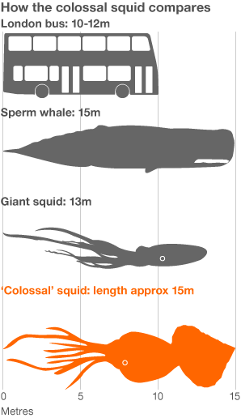
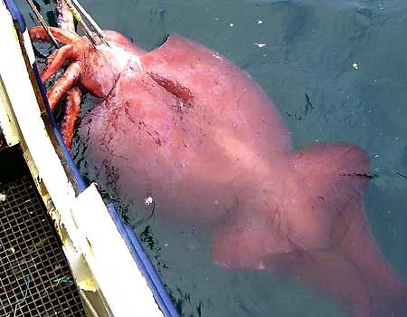
Colossal Squid (Mesonychoteuthis hamiltoni)

Slide 39
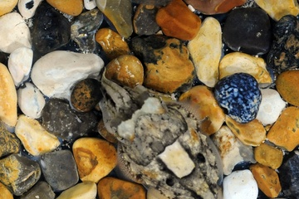

Color Changes in Cephalopods
There are special pigment cells called chromatophores in the skin of most cephalopods.
When these pigment cells expand and deep-sea they can produce color changes controlled by the nervous system
Cephalopods change color for camouflage, and to communicate with other cephalopods.
Many deep- sea squid are bioluminescent.

Slide 40

Mating
Notes:
Fig. 16.40

Slide 41




Direct Development in Cephalopods

Slide 42

The End

